Slide 1
An amateur´s approach to the identification of
Meteorites
Gerhard Drolshagen, Arne Boersma, Björn Poppe
Carl von Ossietzky Universität Oldenburg
IMC 2024, Kutná Hora, 19-22 Sep 2024

Slide 2
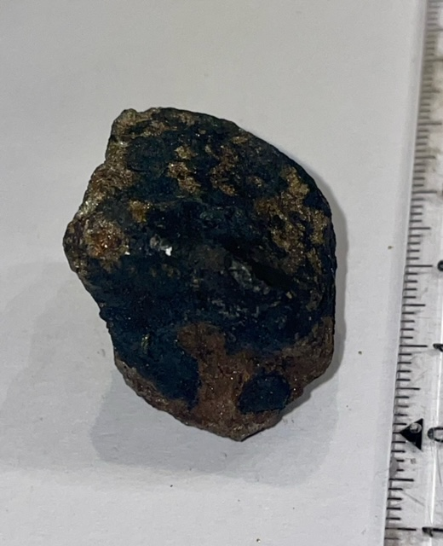
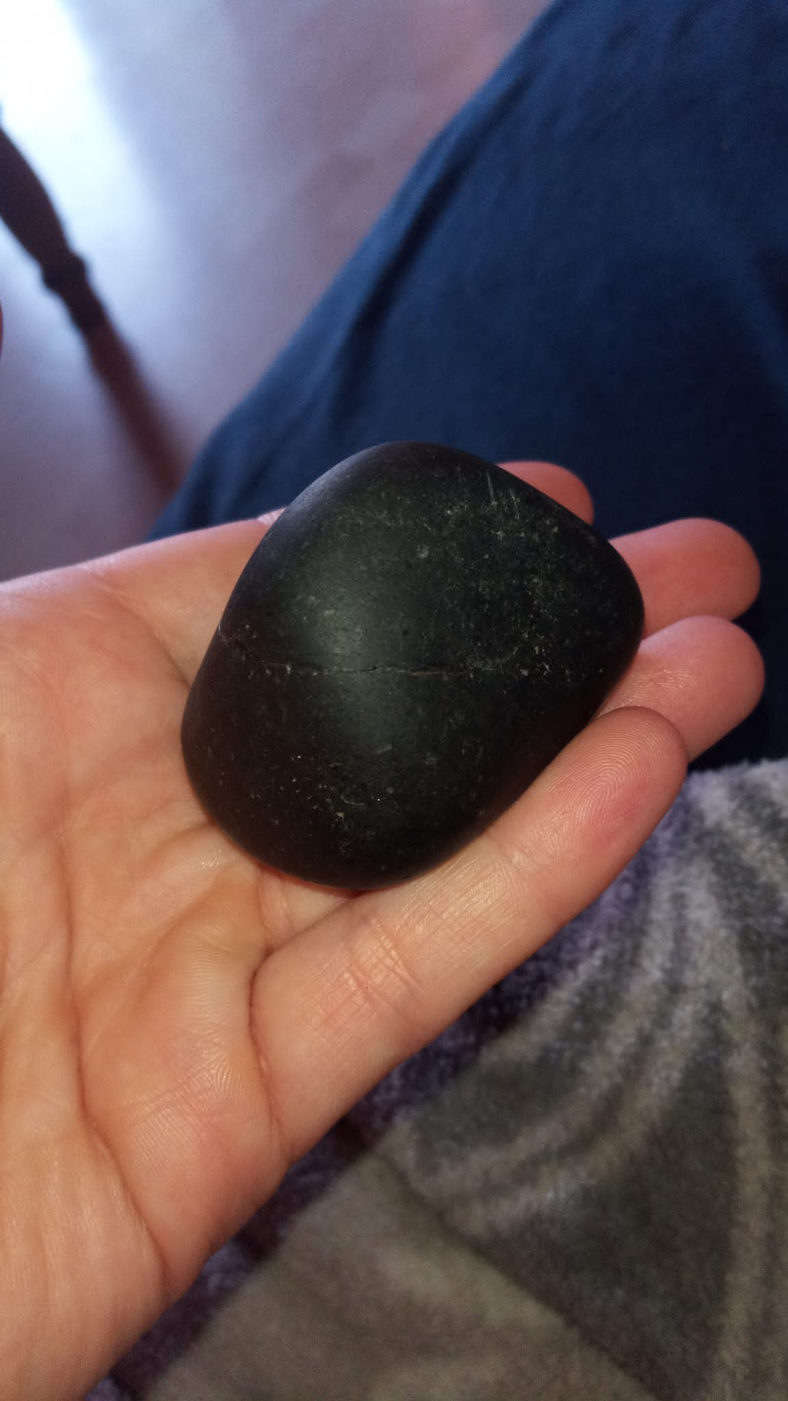
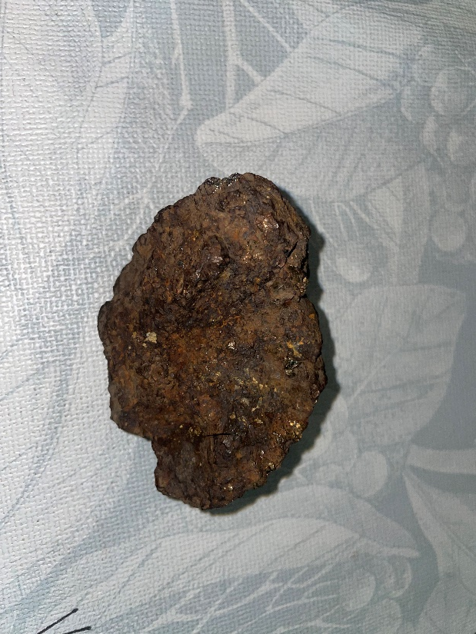
This paper presents the approach of ´Semi-experts´to
analyse ´good´meteorite candidates send to us

Slide 3
We have a website for the general public on how to identify a meteorite
It is in German
It includes a link to send pictures and information about a potential meteorite find
Perhaps it was a bad idea (causes lots of work)

Slide 4
Procedure if we get an inquiry:
Step 1: look at the pictures
That already excludes ca 90 % of candidates as meteowrongs
Step 2: several possibilites (I often ask first Dieter Heinlein for his opinion)
Suggest to find someone to do an RFA analysis
Mention that we cannot identify rare types, like lunar or Martian, meteorites
Offer to send the probe to us

Slide 5
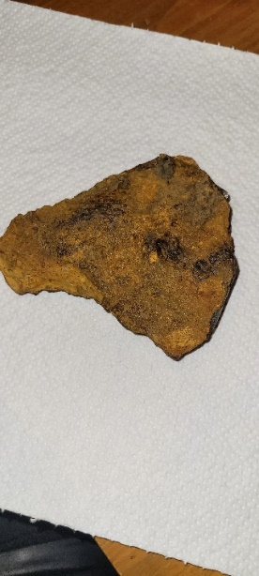
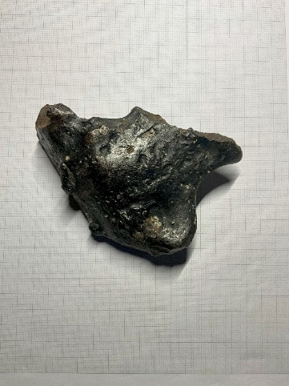
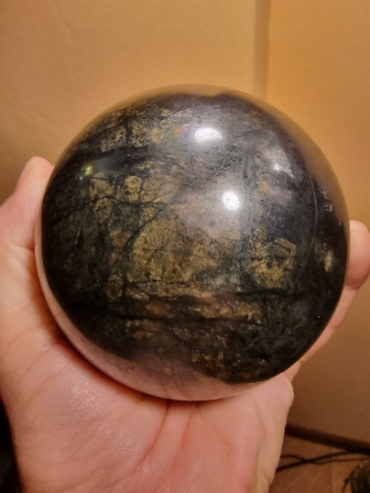
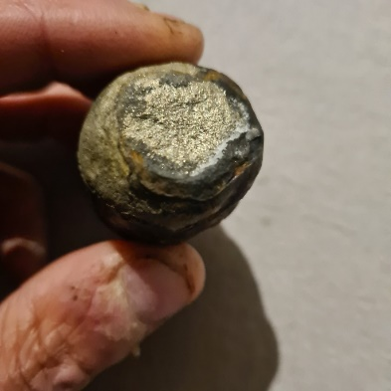
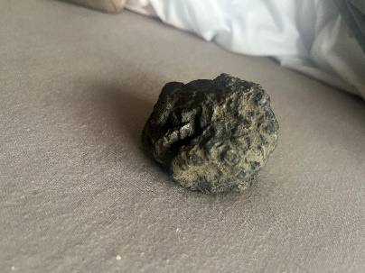
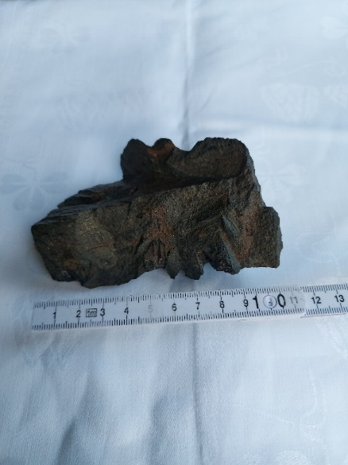
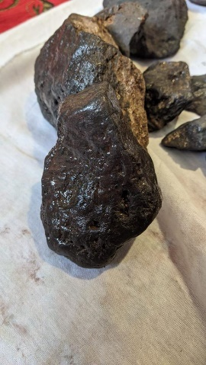
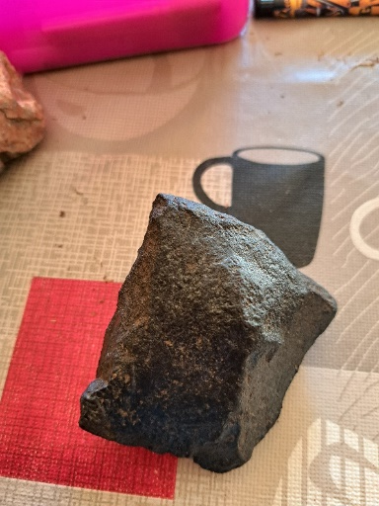
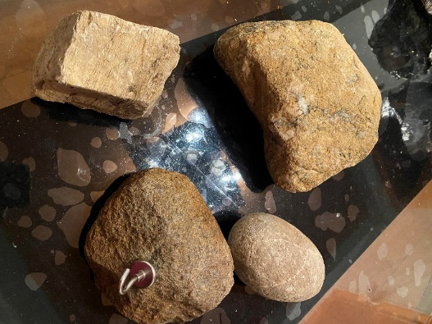
Typical ´meteowrongs´

Slide 6
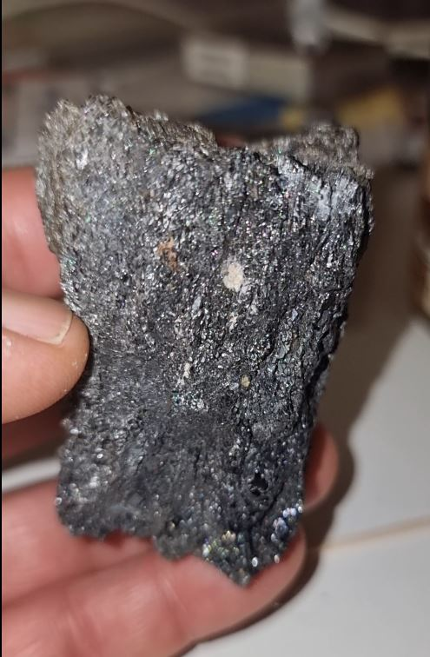
An odd case
Inquiry fom the police in Elmshorn
Someone had filed a claim that a meteorite worth ca 5000 € was stolen from is garden. He send pictures. The stone had not been analysed.
The police wanted to know if the stone could be a meteorite with the indicated worth.
That was easy to answer. I estimated the worth of this slag at < 50 cent.

Slide 7
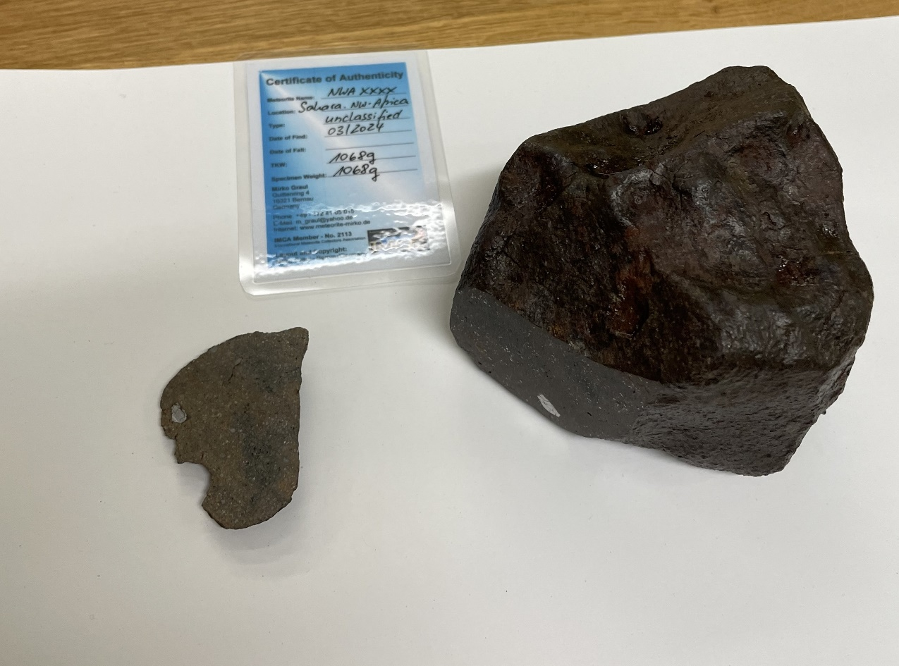
Our measurement options for received probes
An unclassified NWA Ordinary Chondrite as test case

Slide 8
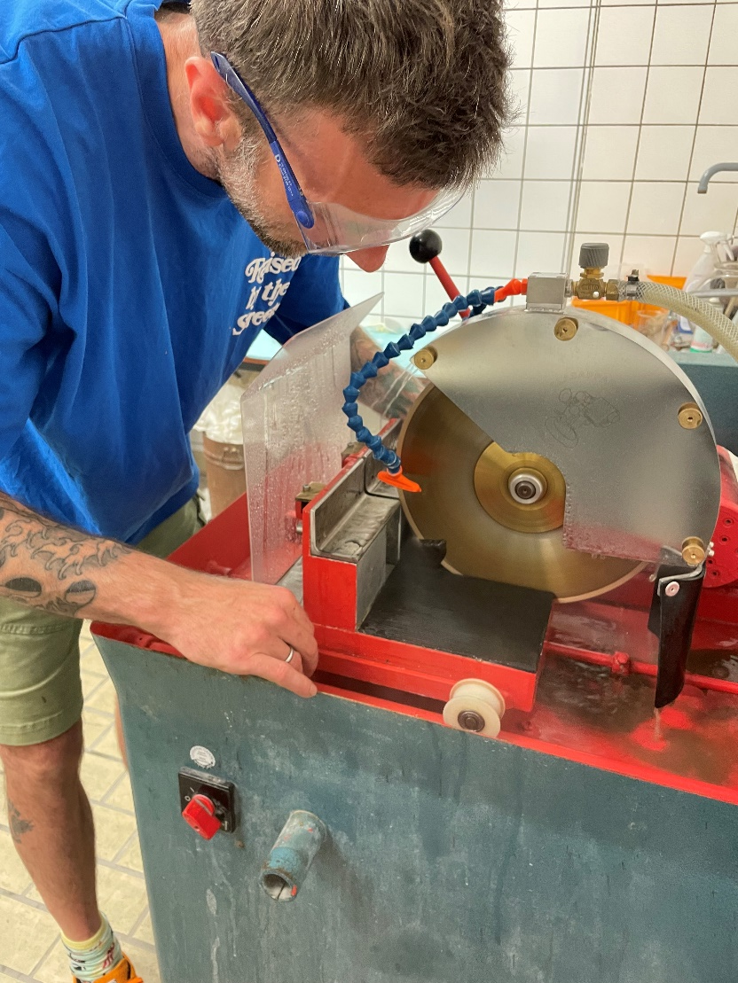
Analysis methods
Cut the probe if required
Water cooled diamond saw at the Univ. Oldenburg
Cut surfaces can show inner matrix and chondrules

Slide 9
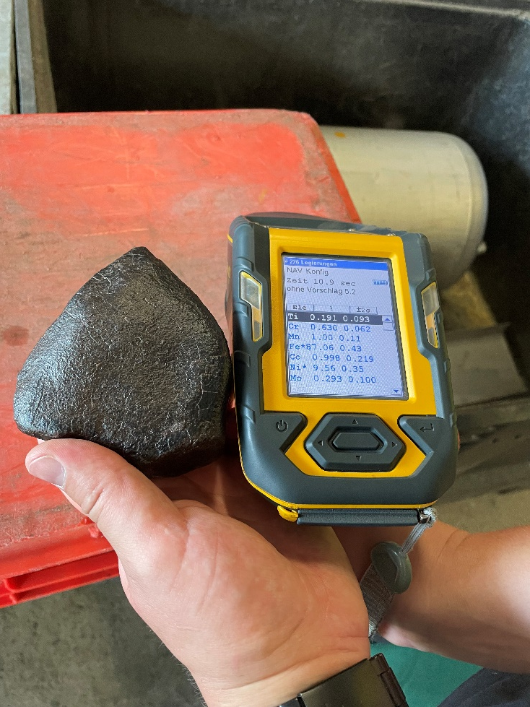
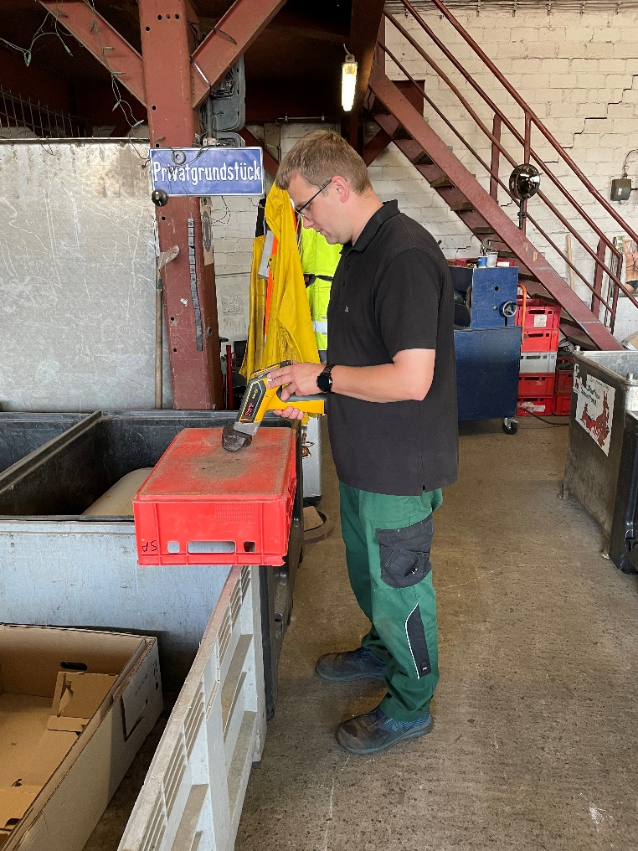
Analysis methods
RFA test with x-ray gun at the scrap yard ´Springer & Sohn´
Cost of equipment: ca 20 000 €

Slide 10
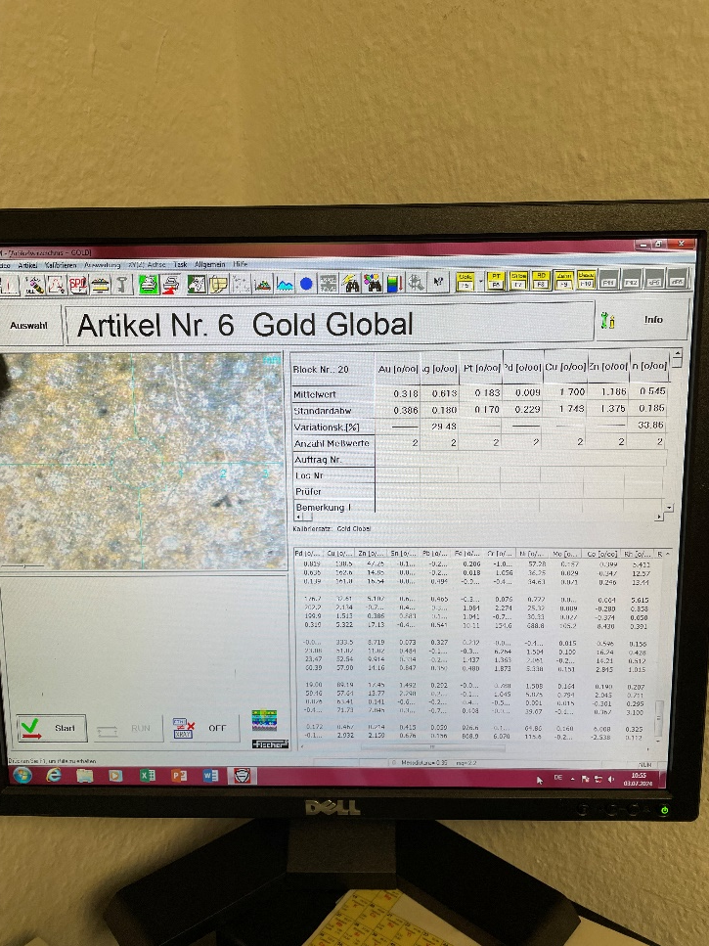
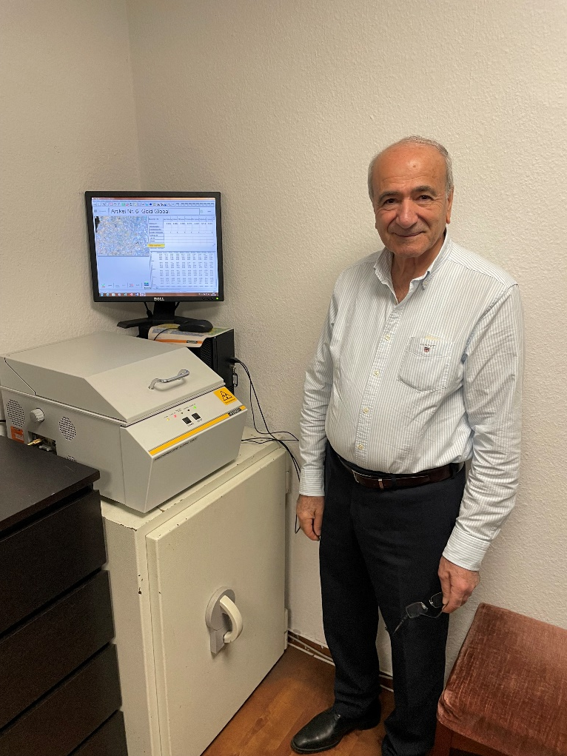
Analysis methods
RFA test with high reliability x-ray device at Jeweler Gabriel
Cost of equipment. ca 40 000 €

Slide 11
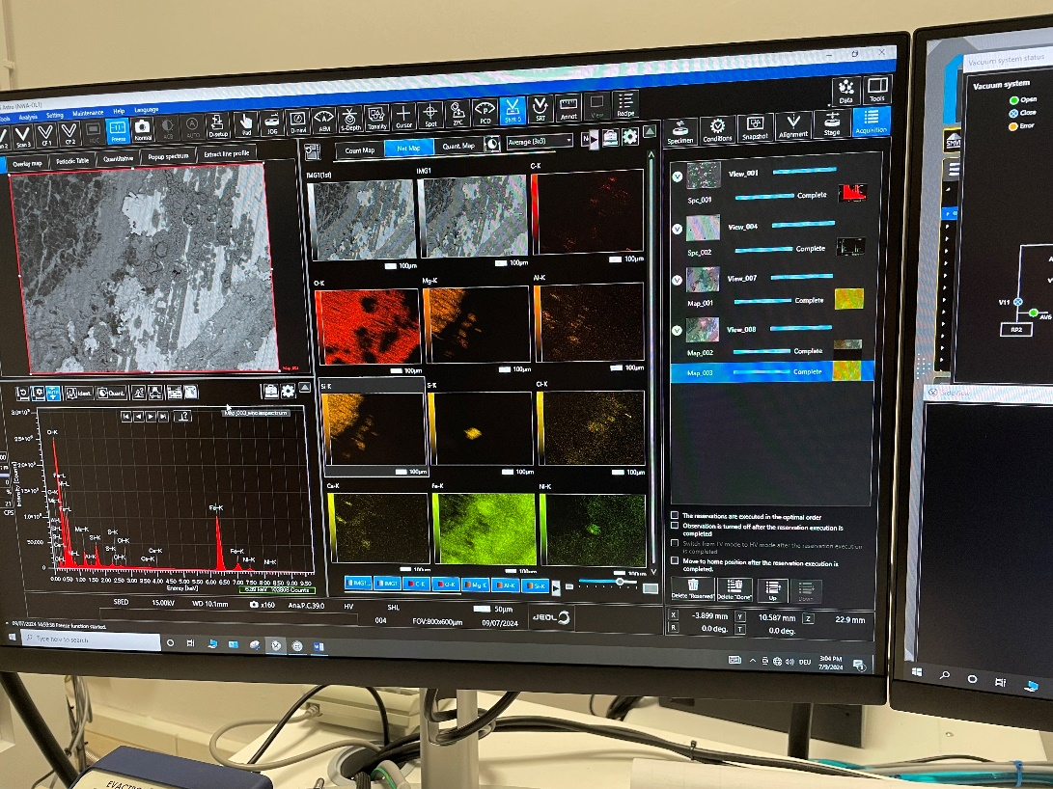
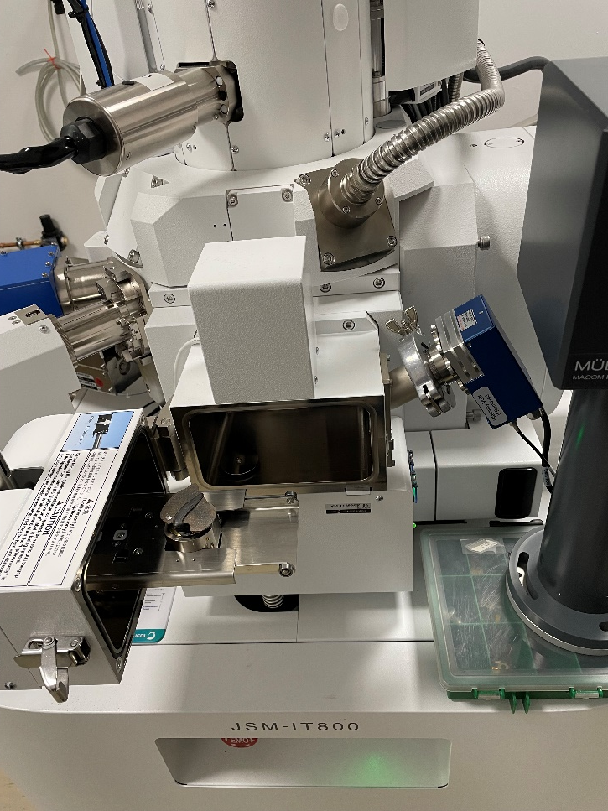
Analysis methods
SEM/EDX analysis at the University Oldenburg
Cost of equipment. ca 800 000 €

Slide 12
Comparison of results from different methods
For unclassified NWA Ordinary Chondrite
Results for Fe, Ni, Co only, in %
The measurements include different elements
Element | X-ray gun, 10 s | X-ray gun 35 s | Jeweler metal corn | Jeweler matrix | EDX
Fe | 87.1 | 51.2 | 92.7 | 87.9 | 10.1
Ni | 9.6 | 3.7 | 6.5 | 11.6 | 0.6
Co | 1.0 | 0.5 | 0.6 | (0.3) | 0.2

Slide 13
Some statistics
Inquiries received: ca 1500
Suggested for an RFA: ca 140
Offered to be analysed by us: ca 40
ca 20 were actually send
Meteorites identified: 1

Slide 14
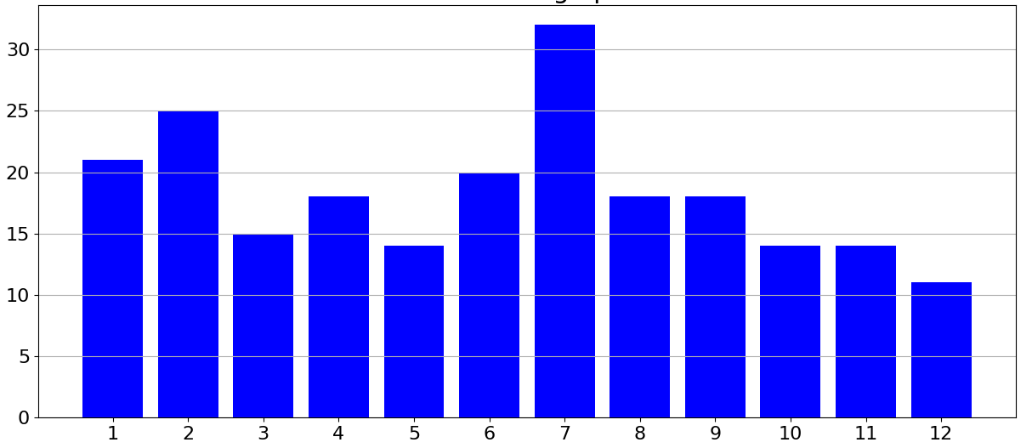
Seasonal distribution of meteorite falls
Number of falls per month of year from 2000-2023
Source: https://galactic-stone.com/pages/falls

